Slide 1
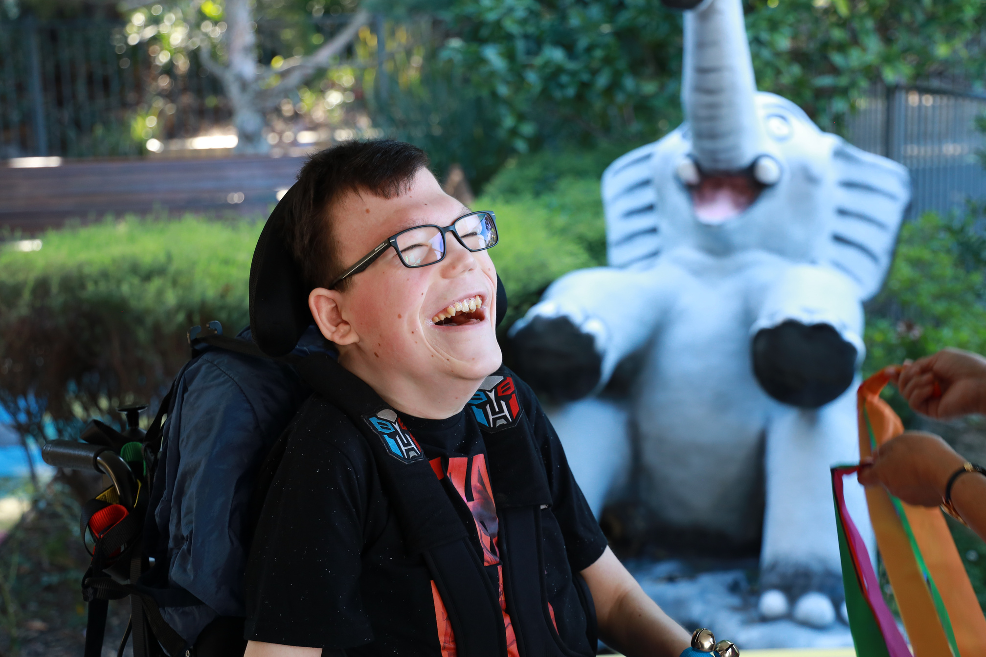

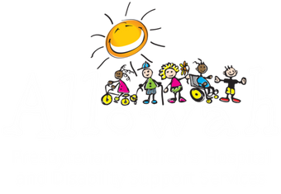

Because
every
SMILE
matters.
Allowah gives kids the specialised support they need to thrive.
Donate Today

