Slide 1



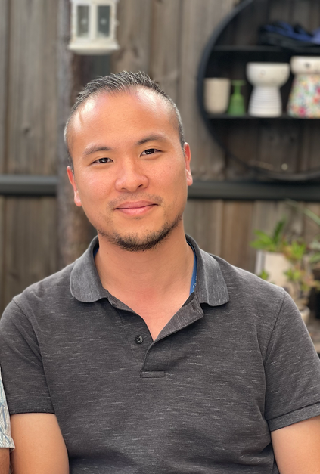
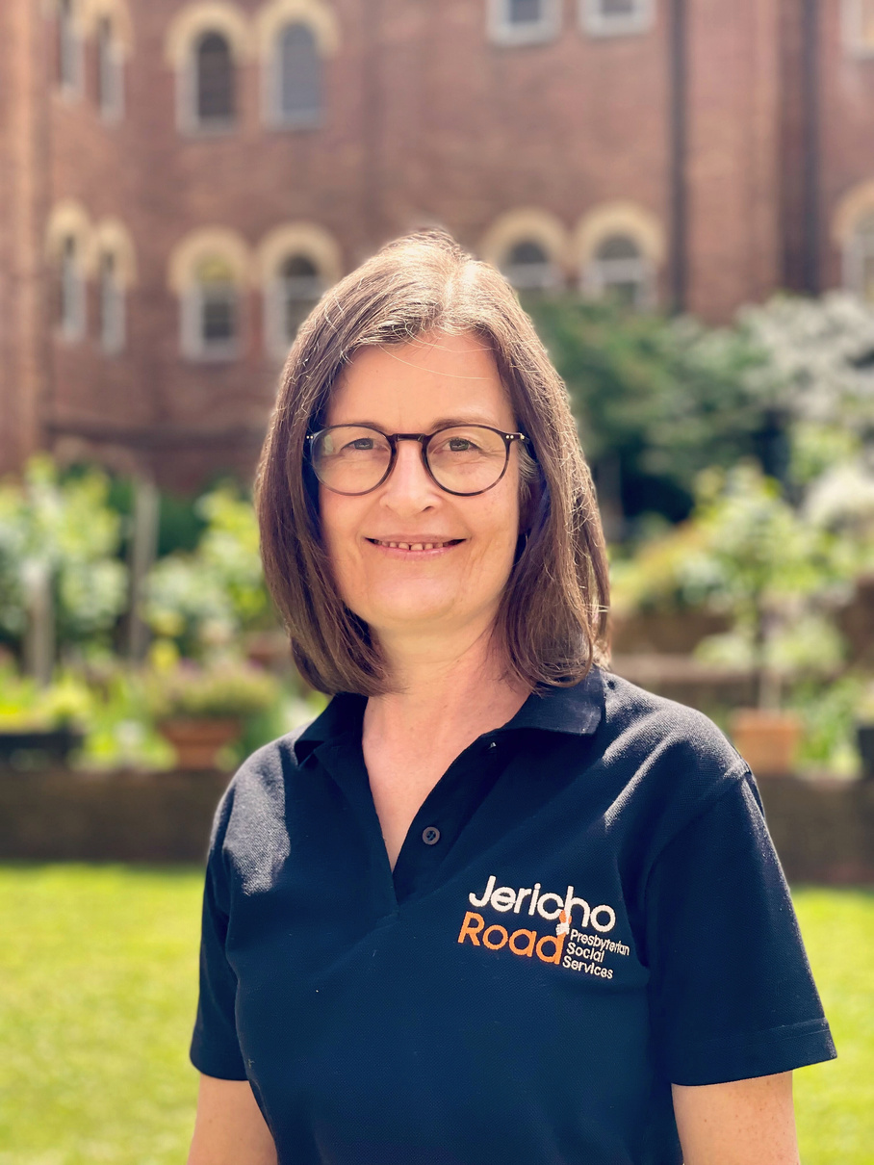
9AM - 10:30AM
Sat 26 Oct
ONLINE PRAYER EVENT

